Slide 1
Structured Knowledge is Still Essential to Understand Sciences
Meng Jiang
University of Notre Dame

Slide 2
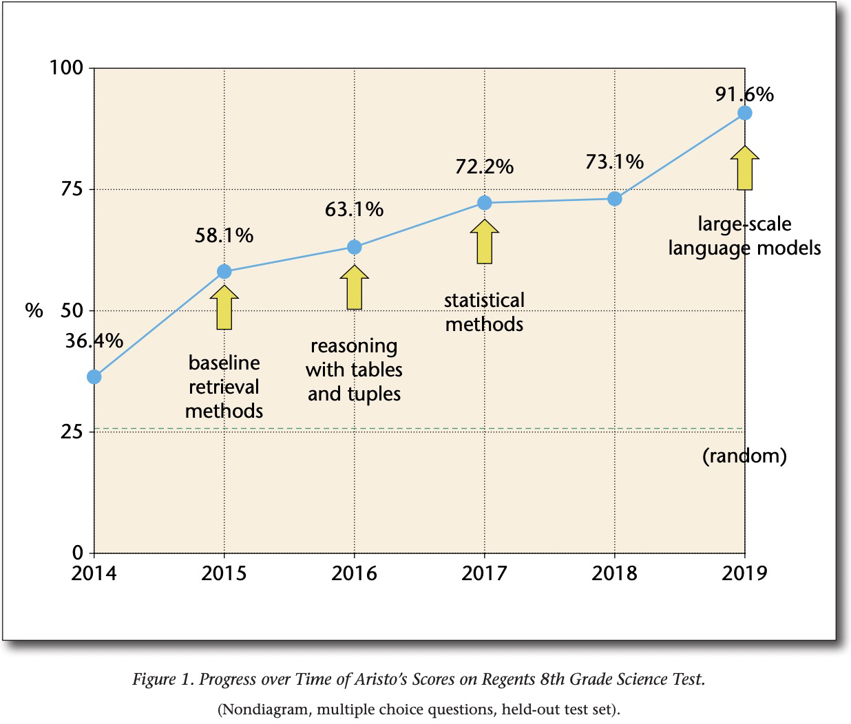
Project Aristo at Allen AI: Machines that pass high school science exams
TEXT In
TEXT Out
LLMs
Transformer
T-5
RoBERTa
GPT-2
175B
GPT-3
SciBERT
BART
DistillBERT
2,048 A100
TEXT in
TEXT out
BERT
How are the particles in a block of iron affected when the block is melted?
The particles gain mass.
The particles contain less energy.
The particles move more rapidly.
The particles increase in volume.
Clark, Peter, et al. “From ‘F’ to ‘A’ on the NY regents science exams: An overview of the aristo project." AI Magazine 41.4 (2020): 39-53.
https://ojs.aaai.org/index.php/aimagazine/article/view/5304

Slide 3
Is structured knowledge still essential?
 | Column header(s)
Row header(s) | Value
Tables/Relational DBs
When language models have understood basic sciences.
Taxonomies
Concept
Attribute
Knowledge Graphs
Relation
Type

Slide 4




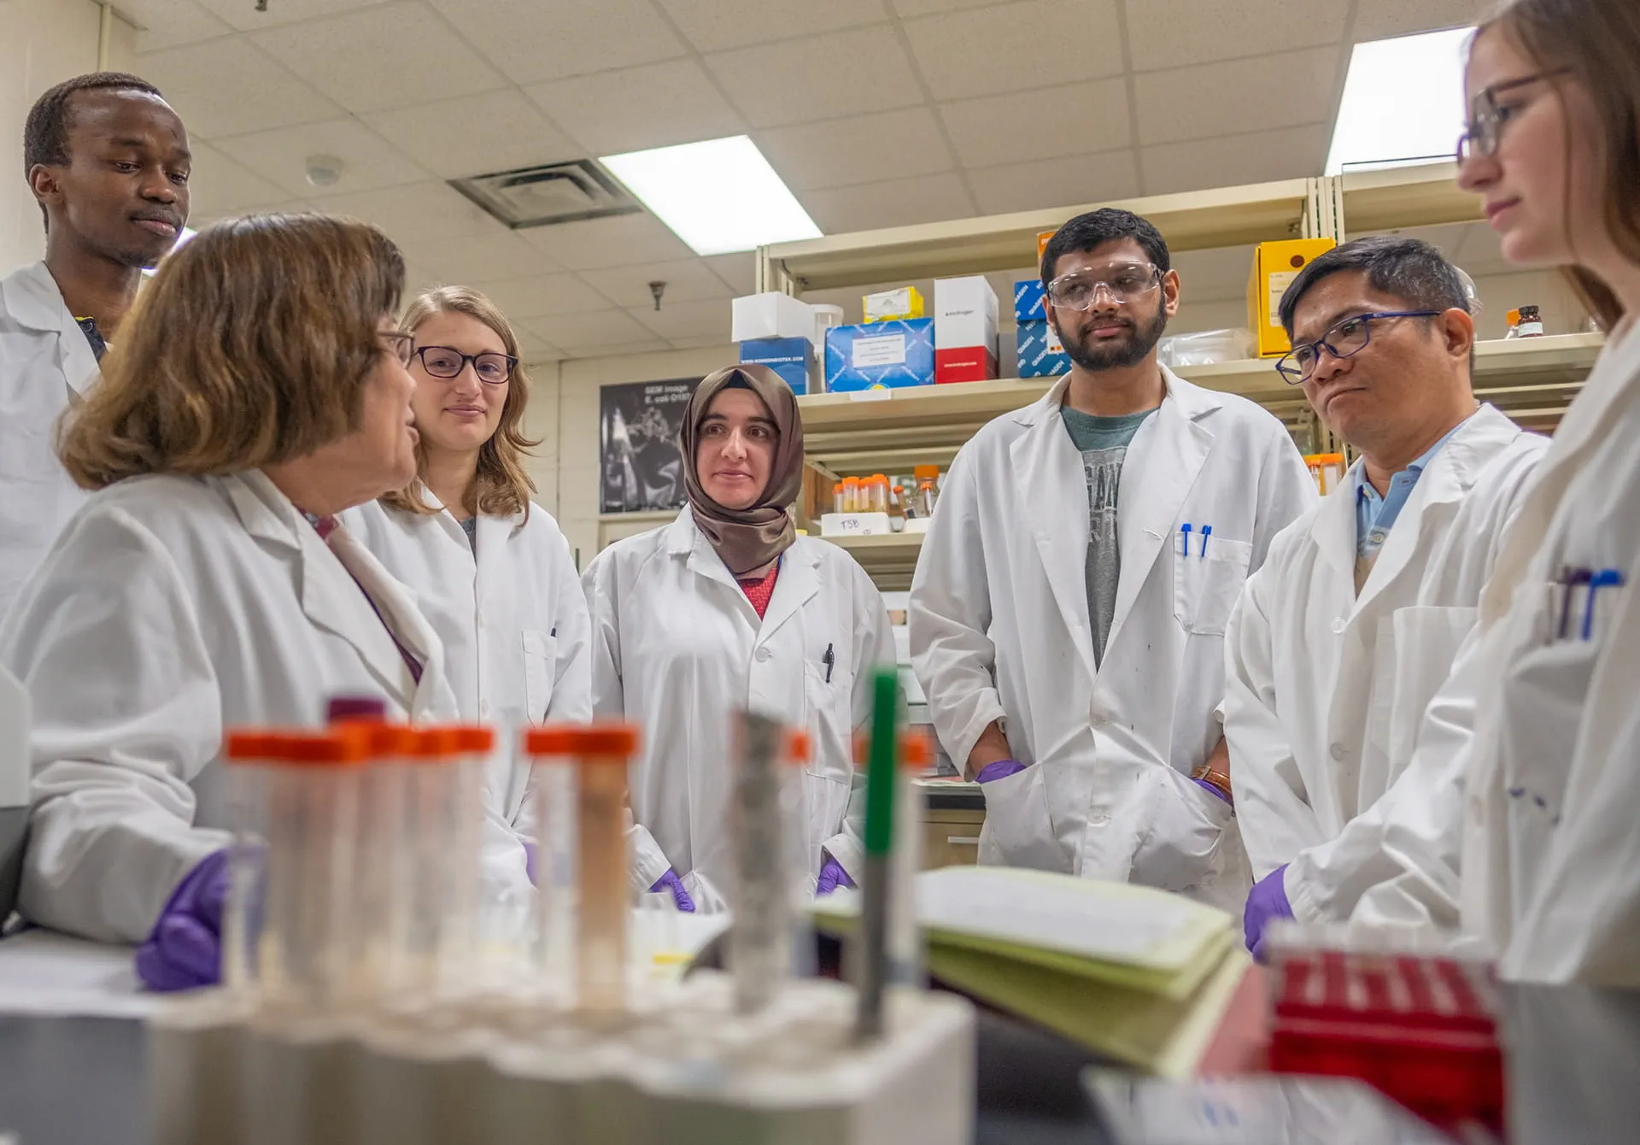

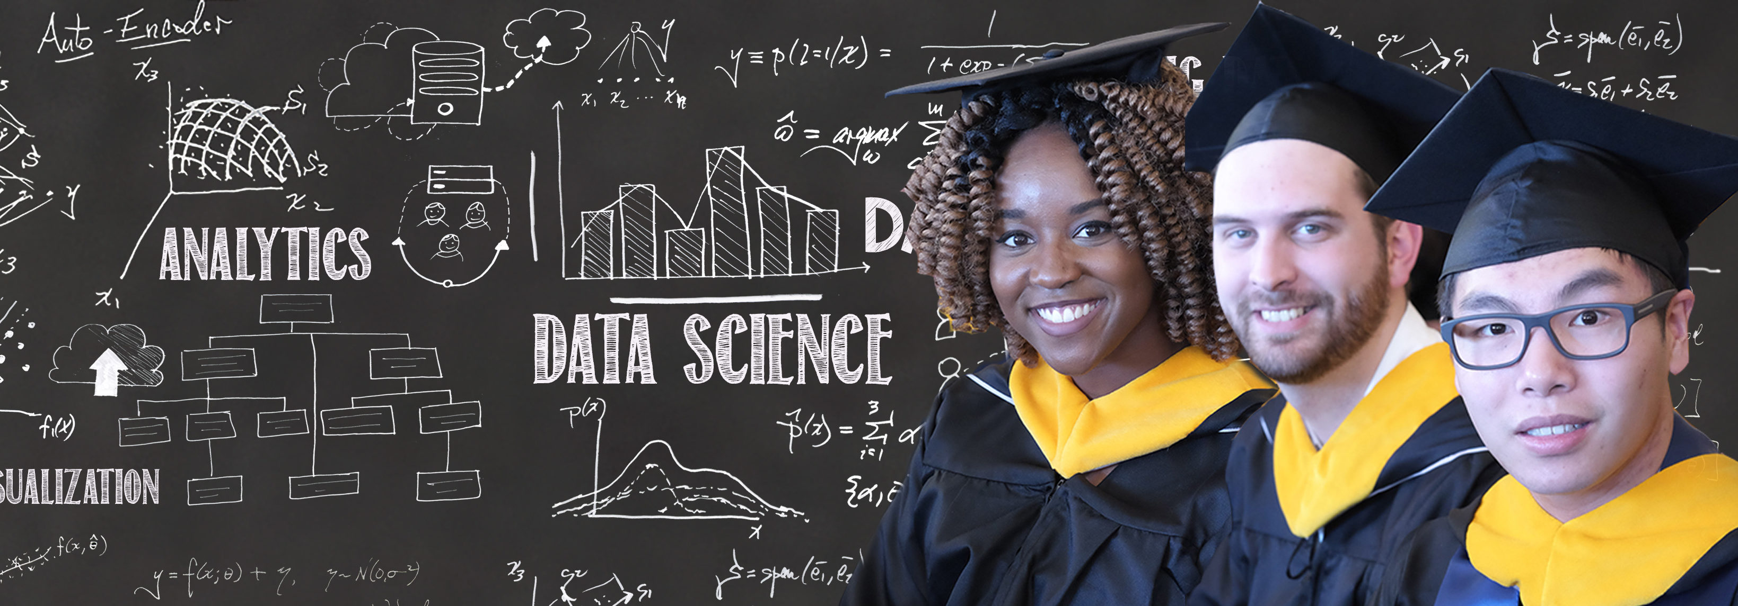

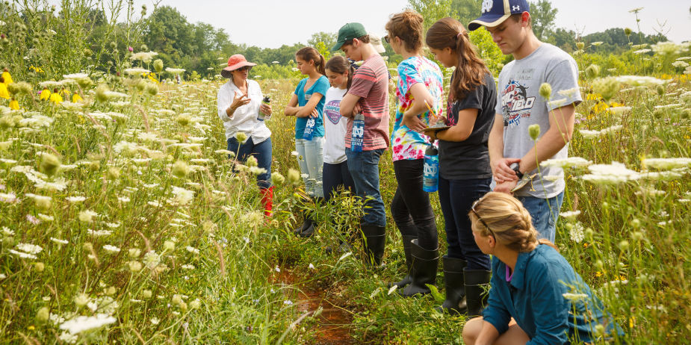
Massive
Growing
Unstructured
Medical scientists
Data scientists
Biologists

Slide 5
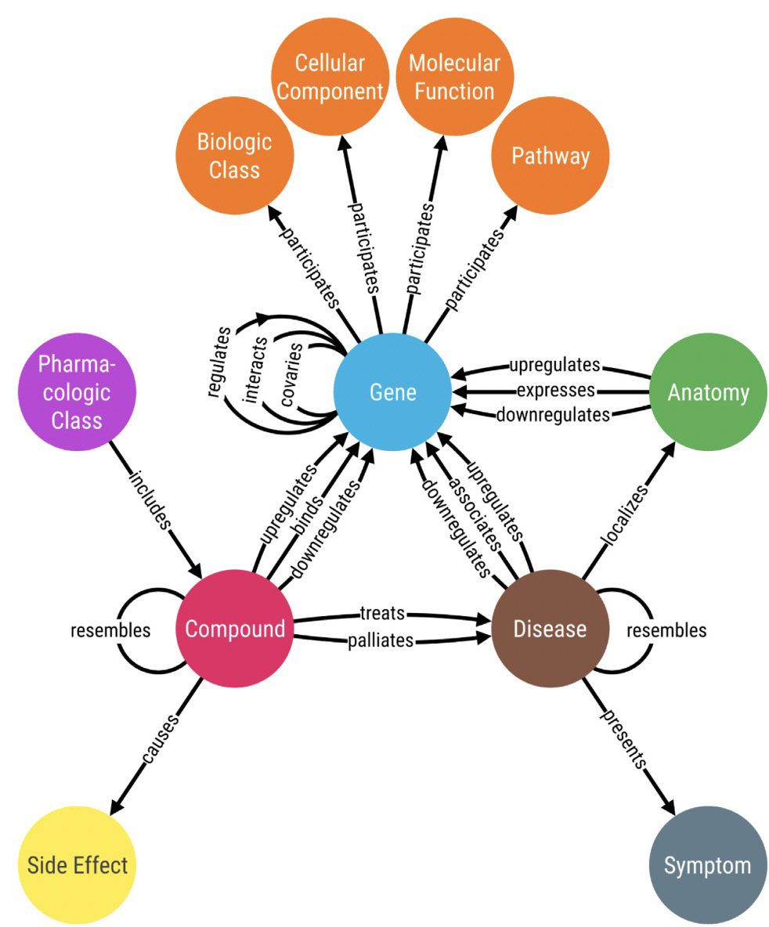
Biomedical Knowledge Graphs
Journal
contains
mentions
Paper
writes
mentions
Author
mentions
works
Institution

Slide 6
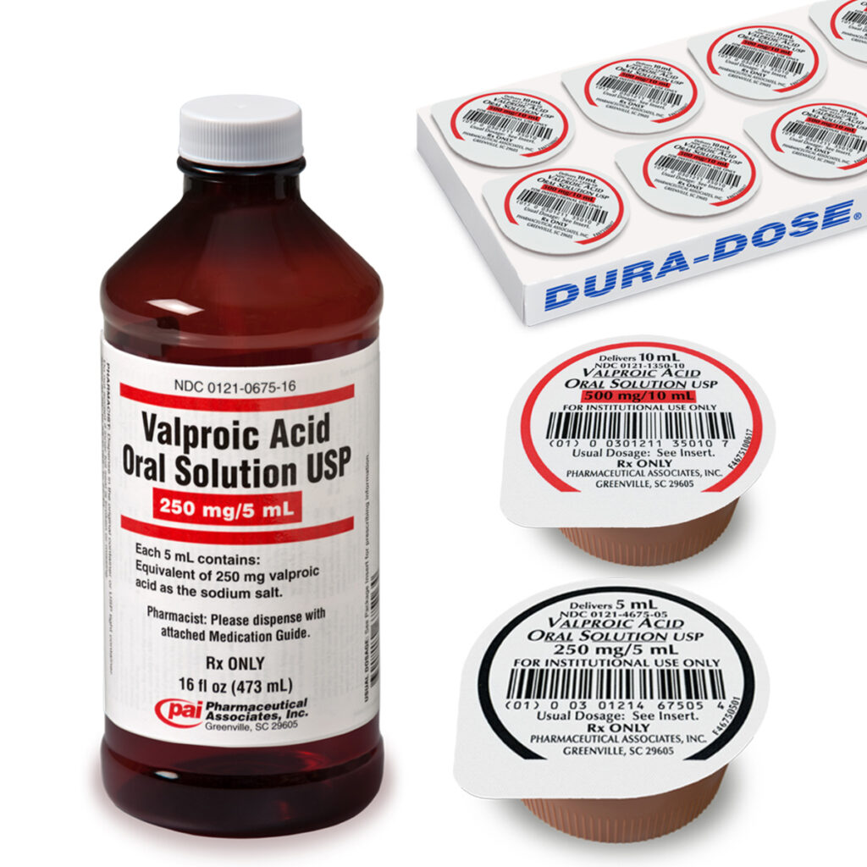
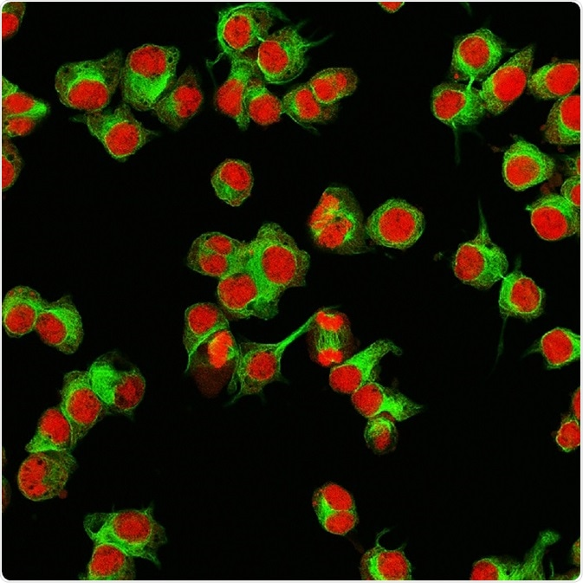
Did valproic acid (VPA; 2-propyl-pentanoic acid) treatment increase or reduce cell proliferation?
Answer: _________ .
VPA treatment
?
cell proliferation
representations
Language Model
Graph Neural Network

Slide 7
Answer: In short, “it depends.”
Increase. “The combined treatment of VPA and PIs (MG132, PI-1 and PR-39) ..”
Increase. “using an in vitro pre-mature senescence model, we …”
Increase. “… through the suppression of the p16/p21 pathway”
…
Reduce. “… by induction of the cell cycle regulator p21 …”
Reduce. “ … by suppressing the ABCC2 and ABCC6 transporters”
Reduce. “… if … involved in the differentiation of hematopoietic cells”
…
Scientists write precise statements of observations / facts and their conditions.
Conditions play a significant role in knowledge representations, reasoning and QA.
Conditions were missing in knowledge graphs.

Slide 8
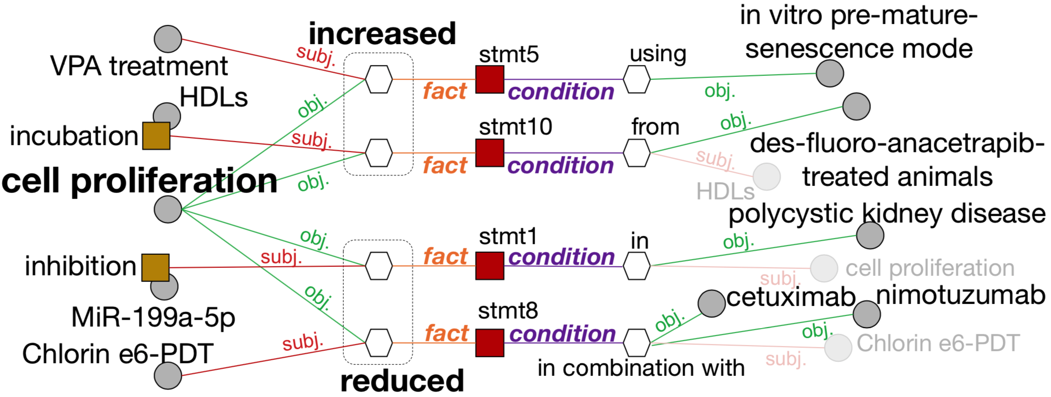
Predicate
Predicate
Concept
Concept
Attribute
Attribute
(facts)
(conditions)

Slide 9
Sequence Labeling Schema
input
We | showed | that | extracellular | acidic | pH | reduces | the | activity | of | TRPV5/V6 | channels | ,
O | O | O | B-f1C | I-f1C | I-f1C | B-f2P | O | B-f3A | O | B-f3C | I-f3C | O
“Begin”
“Concept”
“Predicate”
“object”
1st output
“subject”
“relation”
“Attribute”
“fact”
whereas | alkaline | pH | increases | the | activity | of | TRPV5/V6 | channels | in | Jurkat | T | cells | .
O | O | O | O | O | O | O | O | O | O | O | O | O | O
Fact tuple 1: (extracellular acidic pH, reduces, {TRPV5/V6 channels: activity})

Slide 10
Multiple Output Sequences for Condition Tuples Extraction
We | showed | that | extracellular | acidic | pH | reduces | the | activity | of | TRPV5/V6 | channels | ,
O | O | O | B-f1C | I-f1C | I-f1C | B-f2P | O | B-f3A | O | B-f3C | I-f3C | O
O | O | O | O | O | O | O | O | O | O | O | O | O
O | O | O | O | O | O | O | O | O | O | O | O | O
whereas | alkaline | pH | increases | the | activity | of | TRPV5/V6 | channels | in | Jurkat | T | cells | .
O | O | O | O | O | O | O | O | O | O | O | O | O | O
O | B-f1C | I-f1C | B-f2P | O | B-f3A | O | B-f3C | I-f3C | O | O | O | O | O
O | O | O | O | O | O | O | B-c1C | I-c1C | B-c2P | B-c3C | I-c3C | I-c3C | O
Fact tuple 1: (extracellular acidic pH, reduces, {TRPV5/V6 channels: activity})
Fact tuple 2: (alkaline pH, increases, {TRPV5/V6 channels: activity})
Condition tuple: (TRPV5/V6 channels, in, Jurkat T cells)

Slide 11
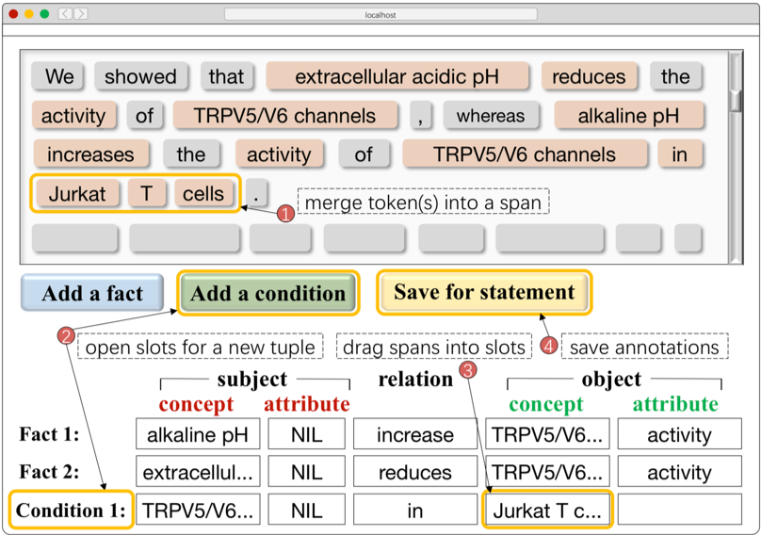
Data Collection
B-f1C | I-f1C | B-c1C | I-c1C
B-f1A | I-f1A | B-c1A | I-c1A
B-f2P | I-f2P | B-c2P | I-c2P
B-f3C | I-f3C | B-c3C | I-c3C
B-f3A | I-f3A | B-c3A | I-c3A
O
3 expert annotators
31 PubMed paper abstracts (docs)
> 30 minutes per anno. per doc
336 statement sentences
756 fact tuples
654 condition tuples
Unlabeled data
15,544,330 documents
140,949,399 sentences

Slide 12
Multi-Input Multi-Output Sequence Labeling (MIMO)
whereas | alkaline | pH | increases | the | activity | of | TRPV5/V6 | channels | in | Jurkat | T | cells | .
NNS | NN | NN | VBZ | DT | NN | IN | NNP | NNS | IN | NNP | NNP | NNS | .
O | B-P | I-P | O | O | B-A | O | B-C | I-C | O | B-C | I-C | I-C | O
Preprocessed by POS tagging, Phrase mining, Concept recognition, Attribute discovery, etc.
O | O | O | O | O | O | O | O | O | O | O | O | O | O
O | B-f1C | I-f1C | B-f2P | O | B-f3A | O | B-f3C | I-f3C | O | O | O | O | O
O | O | O | O | O | O | O | B-c1C | I-c1C | B-c2P | B-c3C | I-c3C | I-c3C | O

Slide 13
 | Token Label Prediction (%) |  |  | Tuple Extraction (%)
 | P | R | F1 / fact, condition | P | R | F1 / fact, condition
Allennlp OpenIE (Stanovsky et al. 2018) | - | - | - | 42.60 | 38.22 | 40.29 / -, -
Stanford OpenIE (Angeli et al. 2015) | - | - | - | 47.11 | 41.62 | 44.19 / -, -
Structured SVM (Tsochantaridis et al. 2015) | 32.68 | 25.80 | 28.83 / 32.76, 24.71 | 47.62 | 46.15 | 46.87 / 45.01, 48.72
CRF (Lafferty et al. 2001) | 60.07 | 41.92 | 49.37 / 56.23, 41.87 | 65.19 | 62.44 | 63.78 / 64/07, 63.44
BiLSTM-LSTMd (Zheng et al. 2017) | 61.00 | 56.26 | 58.53 / 65.16, 51.78 | 71.57 | 66.55 | 68.97 / 69.51, 68.41
MO (BiLSTM based) | - | - | - | 71.80 | 72.34 | 72.07 / 72.39, 71.73
MIMO (BiLSTM based) | 67.80 | 58.24 | 62.66 / 66.67, 58.58 | 75.35 | 74.67 | 75.01 / 74.91, 75.10
BERT-BiLSTM | 70.07 | 70.19 | 70.13 / 74.30, 65.88 | 78.64 | 73.67 | 76.08 / 76.14, 75.99
MO (BERT based) | - | - | - | 77.38 | 79.19 | 78.27 / 76.74, 79.89
MIMO (BERT based) | 75.91 | 71.08 | 73.41 / 76.01, 70.75 | 81.06 | 80.53 | 80.79 / 79.94, 81.64
PUBLICATIONS
Jiang et al. “The Role of Condition: A Novel Scientific Knowledge Graph Representation and Construction Model” ACM SIGKDD 2019.
Jiang et al. “Multi-input Multi-output Sequence Labeling for Joint Extraction of Fact and Condition Tuples from Scientific Text” EMNLP 2019.
Jiang et al. “CTGA: Graph-based Biomedical Literature Search” IEEE BIBM 2019.
Jiang et al. “Biomedical Knowledge Graphs Construction from Conditional Statements” IEEE/ACM TCBB 2021.

Slide 14
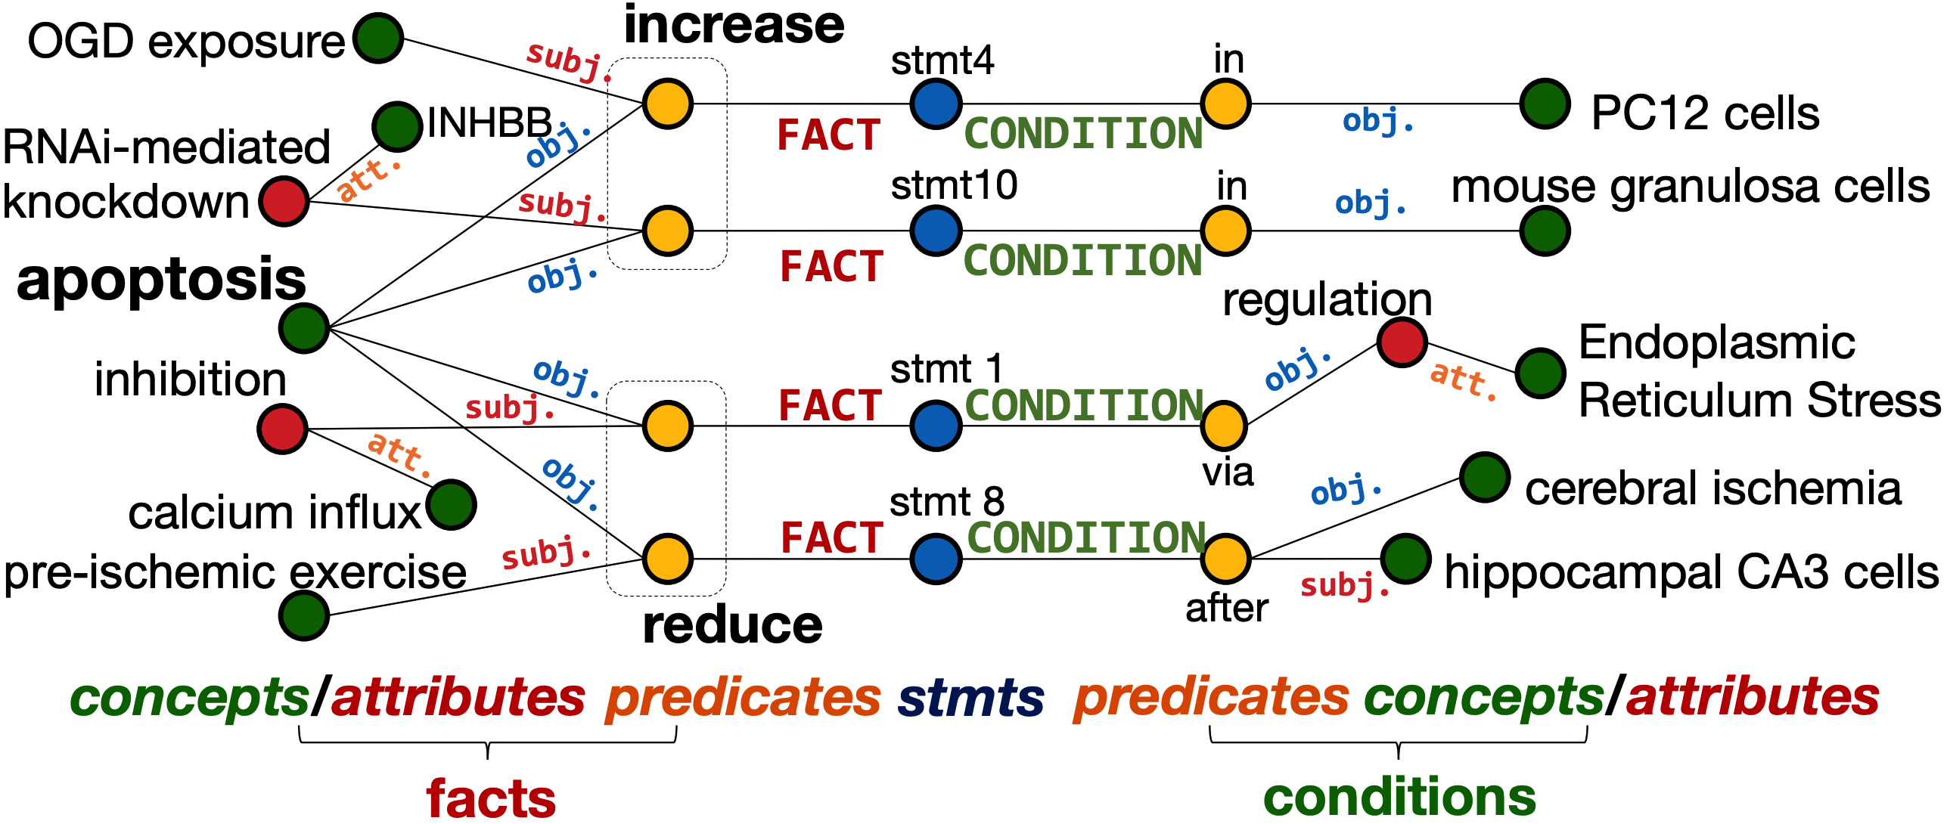
What can be automatically extracted / built?

Slide 15



collaborator / co-author
manager / advisor / mentor
What is the state-of-the-art (SOTA)?
Answer: _________ .
reviewers
What are the limitations of SOTA?
Answer: _________ .

Slide 16
To identifying SOTA automatically, ideally…
Benchmarking
Open-source
Reproducibility

Slide 17
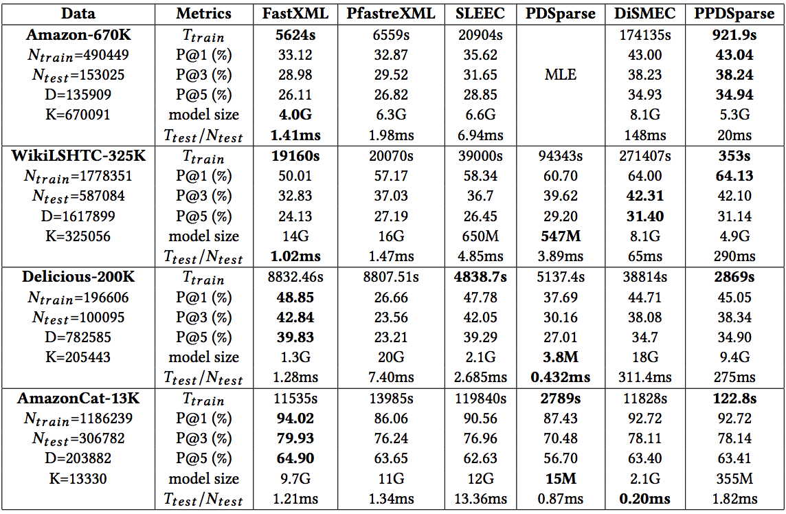
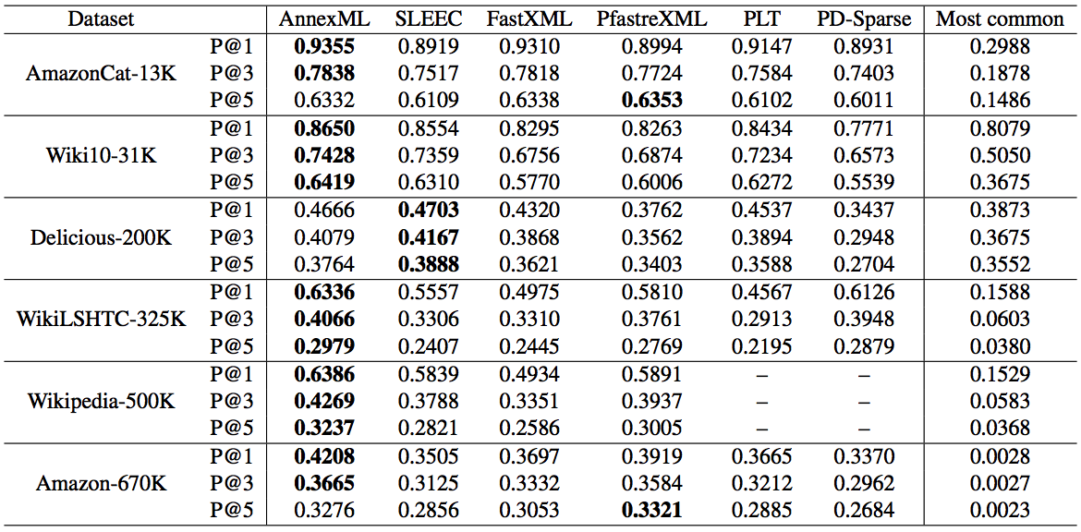
Q: “What is the SOTA in extreme (multi-label) classification?”
“PPDSparse: A Parallel Primal-Dual Sparse Method for Extreme Classification” KDD 2017.
“AnnexML: Approximate Nearest Neighbor Search for Extreme Multi-label Classification” KDD 2017.
underlined:
When the difference of reported scores is bigger than 3.0.

Slide 18
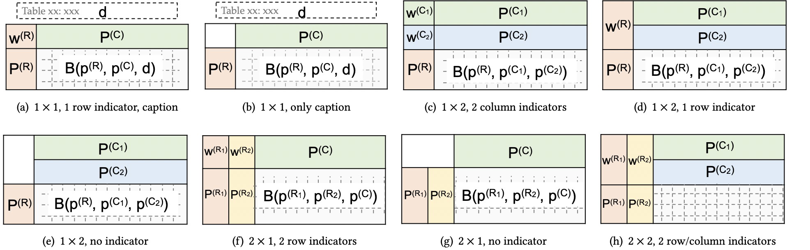
Reading Tables like a Data Scientist: Table Template Recognition
Identifying (dataset, metric, method, score) from
single/double row/column indicators and captions.
The following eight templates cover 99% of thousands of tables we collected from DM/ML/AI/NLP venues.

Slide 19
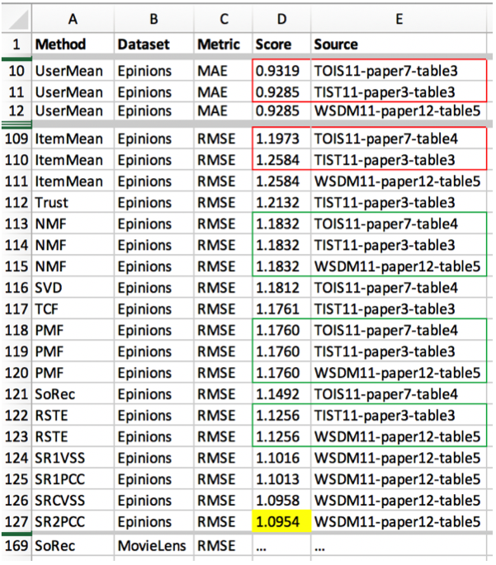

Slide 20
T
A
B
L
E
P
E
D
I
A
How many methods were used for the Epinions dataset?
Answer: 36 : “UserMean”, “ItemMean”, “Trust”, “NMF”, “SVD”, “TCF”, “PMF”, “SoRec”, “RSTE” …
What are the top 3 methods on Amazon in terms of F1 score?
Answer: “LEMON” (0.953), “LEMON-auto” (0.91), “LC” (0.815) .
Can you find conflicting reported scores?
Answer: Yes .
How many metrics were used for Epinions?
Answer: 7 : “F1 score”, “Precision”, “Recall”, “MAE”, “RMSE” …
What are the top 3 methods on Epinions in terms of RMSE?
Answer: “SR2pcc” (1.0954), “SR2vss” (1.0958), “SR1pcc” (1.1013) .
PUBLICATIONS
Yu et al. “Tablepedia: Automating PDF Table Reading in an Experimental Evidence Exploration and Analytic System” The Web Conference 2019.
Yu et al. “Experimental Evidence Extraction in Data Science with Hybrid Table Features and Ensemble Learning” The Web Conference 2020.
Wang et al. “TCN: Table Convolutional Network for Web Table Interpretation” The Web Conference 2021.

Slide 21
What are the limitations of SOTA? Answer: _________ .
Factorization Tricks for LSTM Network
Oleksii Kuchaiev
Boris Ginsburg
(2017)
… [21]
Outrageously large neural networks: The sparsely-gated mixture-of-experts layer
Noam Shazeer, Azalia Mirhoseini,
Krzysztof Maziarz, Andy Davis, Quoc Le,
Geoffrey Hinton, Jeff Dean (2017)
… [32]
1
2
Attention is All You Need (“Transformer”)
Ashish Vaswani, Noam Shazeer, Niki Parmar, Jakob Uszkoreit, Llion Jones, Aidan N Gomez, Łukasz Kaiser, Illia Polosukhin (2017)
Recurrent models typically factor computation along the symbol positions of the input and output sequences. …
Recent work has achieved significant improvements in computational efficiency through factorization tricks [21] and conditional computation [32], while also improving model performance in case of the latter. The fundamental constraint of sequential computation, however, remains.
3

Slide 22
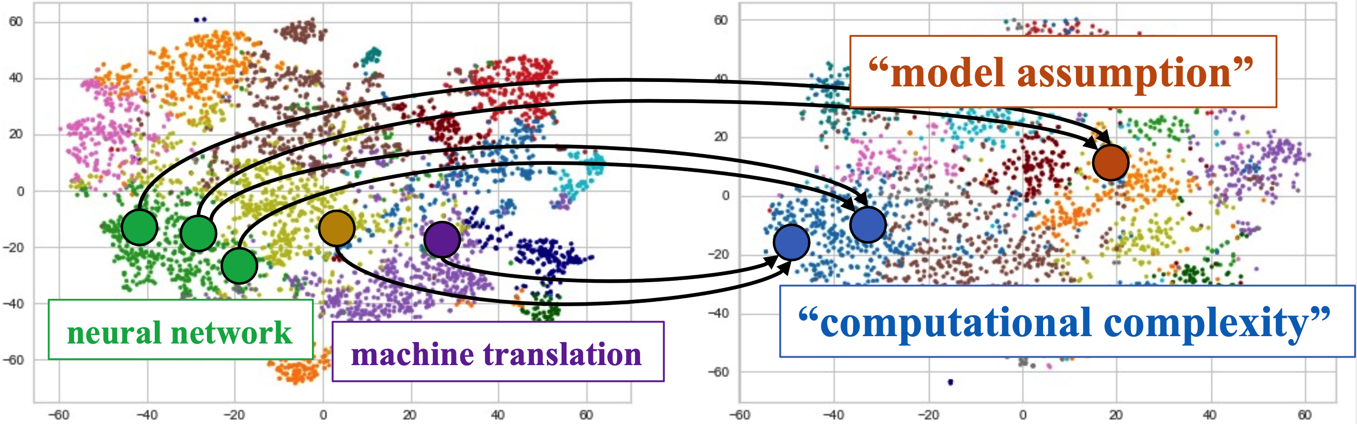
Topic Spaces Gap between Input and Output
BERT then 2d t-SNE embedding
Input:
Output:
Cited papers , their summary
“However” sentences
(comparative arguments)
1
2
3

Slide 23
The comparison topic is hard to predict
and important for argument generation.
Cited
papers
Summary
Comparison topic
Language Model
 | B-2 | B-4 | R-2 | R-L | MTR
No topic | 14.27 | 5.56 | 10.66 | 27.96 | 12.68
+Predicted | 14.81 | 6.11 | 11.67 | 28.30 | 12.77
+Annotated | 16.19 | 6.75 | 12.75 | 30.18 | 13.91
Comparative argument
0
7% (MTR), 15% (R-L), 28% (B-2)
100%
PUBLICATION
Yu et al. “Scientific Comparative Argument Generation” The Document Intelligence Workshop (DI) at SIGKDD 2022.
No topic
+Predicted
+Annotated
Future work: Reasoning comparison topics

Slide 24
chemical
phenomena
…
?
biochemical phenomena
?
…
protein folding
protein stability
?
?
?
?
…
MeSH taxonomy (~30,000 concepts)

Slide 25
Taxonomy Construction: Concept-then-Relation Extraction
Rank
Frequency
10⁶
chemical
phenomena
…
1
dna
phosphorylation
10⁵
10⁴
30,000 (size of MeSH)
10³
organic chemistry phenomena
biochemical phenomena
photochemical processes
…
100,000
4,667,233
documents
from PubMed
(250GB)
300,000
photolysis
glycosylation
hydroxylation
nitrogen cycle
protein folding
photosynthesis
10²
phosphorylation
oxidative coupling
protein stability
biochemical phenomena
protein multimerization
phototrophic processes
photophosphorylation
nucleic acid denaturation
…
nucleic acid renaturation
10¹
…
…
600,000
nucleic acid renaturation
Many concepts have too small frequency (even ZERO) to be accurately placed onto the taxonomy.

Slide 26
New Methodology: Generate Concepts Word by Word
 | # Concepts | # Words
MAG-CS | 29,484 | 16,398
Found in corpus | 18,338 (62.2%) | 13,914 (84.9%)
MeSH | 29,758 | 22,367
Found in corpus | 14,614 (47.6%) | 22,193 (99.2%)
A
?
B
C
D
A is a class of ___
B is a sibling of ___
C is a subclass of ___
D is a subclass of ___
?
Frequency
A
C
D
10⁸
?
acid
nucleic
phenomena
biochemical
…
renaturation
…
10⁷
10⁶
Text
encoder
Top-down
subgraph GNN
Bottom-up
subgraph GNN
10⁵
10⁴
Text
decoder
“nucleic acid renaturation”
fused hidden state
10³

Slide 27
Results
 | P | R | F1 | P | R | F1
 | MeSH |  |  | DroneTaxo
HIEXPAN | 17.77 | 5.66 | 8.59 | 43.24 | 30.77 | 35.95
TAXOEXPAN | 26.87 | 11.79 | 16.39 | 60.98 | 48.08 | 53.77
GRAPH2TAXO | 26.13 | 10.35 | 14.83 | 44.90 | 23.31 | 30.69
STEAM | 26.05 | 11.23 | 15.69 | 58.33 | 53.85 | 56.00
ARBORIST | 26.19 | 10.76 | 15.25 | 52.38 | 42.31 | 46.81
TMN | 23.73 | 9.84 | 13.91 | 47.72 | 40.38 | 43.74
GENTAXO | 22.61 | 17.66 | 19.83 | 65.96 | 59.62 | 62.63
 | SemEval-Sci |  |  | SemEval-Env
HIEXPAN | 14.63 | 10.34 | 12.12 | 15.79 | 8.11 | 10.72
TAXOEXPAN | 24.14 | 29.17 | 26.42 | 23.07 | 16.22 | 19.05
GRAPH2TAXO | 26.19 | 18.96 | 21.99 | 21.05 | 10.81 | 14.28
STEAM | 35.56 | 27.58 | 31.07 | 46.43 | 35.13 | 39.99
ARBORIST | 41.93 | 22.41 | 29.21 | 46.15 | 32.43 | 38.09
TMN | 34.15 | 24.14 | 28.29 | 37.93 | 29.73 | 33.33
GENTAXO | 38.78 | 32.76 | 35.52 | 48.28 | 37.84 | 42.42
Consistent improvement
in terms of
Recall and F1 score,
because
missing or infrequent concepts were generated.
PUBLICATION
Zeng et al. “Enhancing Taxonomy Completion with Concept Generation via Fusing Relational Representations” ACM SIGKDD 2021.

Slide 28
Efficient generation
Encoder-Decoder with Entity Memory
(Zhang et al. EMNLP 2022)
Tables
Diversified generation
Mixture of KG Experts
(Yu et al. ACL 2022)
Knowledge
Graphs
Memory
Dictionaries
Dict-BERT
(Yu et al. ACL 2022)
Retrieval augmentation
RAug
(Yu et al. EMNLP 2022)
Taxonomies

Slide 29
On Language Modeling Mechanisms
Recent Research Publications
[Open-Book + QA + Reasoning] Yu et al. “Retrieval Augmentation for Commonsense Reasoning: A Unified Approach” EMNLP 2022.
[Memory + QA + Generation] Zhang et al. “A Unified Encoder-Decoder Framework with Entity Memory” EMNLP 2022.
[Knowledge-Graph + Generation + Reasoning + Diversity] Yu et al. “Diversifying Content Generation for Commonsense Reasoning with Mixture of Knowledge Graph Experts” ACL 2022.
[Dictionary + LM + Pre-training] Yu et al. “Dict-BERT: Enhancing Language Model Pre-training with Dictionary” ACL 2022.
[Open-Book+ QA + Generation] Yu et al. “Generate rather than Retrieve: Large Language Models are Strong Context Generators” ICLR 2023.

Slide 30
Take Away
Scientist job is not simple:
Scientists write statements precisely;
Scientists read tables and papers critically;
Scientists create taxonomies professionally.
Structured knowledge is essential:
Knowledge graphs representing conditions.
Data tables integrating experimental results.
Comparison topics indicating SOTA limitations.
Taxonomies built with word-by-word generator.
Tablepedia
Conditional tuples
QA
MIMO
“However”
GenTaxo
missing concepts
(method, metric, dataset)

Slide 31

Can AI receive a PhD in five years?
mjiang2@nd.edu

